Slide 1









NXGN
TRIVIA
QUIZ
LET’S PLAY!

Slide 2

how to play
PERTANYAAN AKAN DITUNJUKKAN DAN SETELAH HITUNGAN KETIGA, HARUS CEPET-CEPETAN ANGKAT TANGAN. YANG DULUAN BOLEH MENJAWAB. KALAU SALAH KELOMPOK SATUNYA AKAN DIBERIKAN KESEMPATAN UNTUK MENJAWAB KEMBALI. POIN SETIAP PERTANYAAN BERBEDA!

Slide 3
ARE YOU READY?

Slide 4
1

Slide 5


Answer the question
Siapa penulis lagu kebangsaan Indonesia?

Slide 6
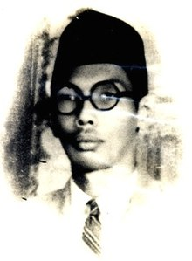
Answer the question
Answer:
W. R. Soepratman

Slide 7
Answer the question
+5

Slide 8
2

Slide 9
Answer the question
GBI Vifa sekarang punya berapa cabang?

Slide 10
Answer the question
Answer:
8

Slide 11
Answer the question
+3

Slide 12
3

Slide 13
Answer the question
Apa tema NXGN bulan ini?

Slide 14
Answer the question
Answer:
“KEEP ON FIRE”

Slide 15
Answer the question
+8

Slide 16
4

Slide 17
Answer the question
CHARADES

Slide 18
Answer the question
Answer:
“monyet encok”

Slide 19
Answer the question
+4

Slide 20
5

Slide 21
Answer the question
tes kemampuan matematika kalian yuk! hehe

Slide 22
Answer the question
Answer:
64

Slide 23
Answer the question
+5

Slide 24
6

Slide 25
Answer the question
Lengkapi lyrics lagu ini!

Slide 26
Answer the question
___________ ajaib
Terukir dalam kehidupanku

Slide 27
Answer the question
Answer:
Kupercaya janji-Mu ajaib
Terukir dalam kehidupanku

Slide 28
Answer the question
+10

Slide 29
7

Slide 30
Answer the question
Apa 3 pembagian zona waktu di Indonesia?

Slide 31
Answer the question
Answer:
WIB. WITA, WIT

Slide 32
Answer the question
+7

Slide 33
8

Slide 34
Answer the question
siapakah aku?

Slide 35


Slide 36
Answer the question
Answer:
Ronal

Slide 37
Answer the question
+7

Slide 38
9

Slide 39
Answer the question
Siapa nama pendeta ini?

Slide 40
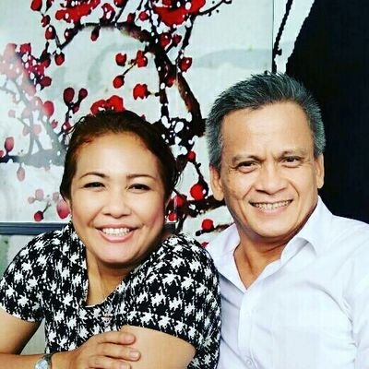
Answer the question

Slide 41
Answer the question
Answer:
Jacky Mailoor

Slide 42
Answer the question
+3

Slide 43
10

Slide 44
Answer the question
Hewan apa yang selalu benar?

Slide 45
Answer the question
Answer:
Kucing Ga-Wrong

Slide 46
Answer the question
+9

Slide 47
11

Slide 48
Answer the question
Hewan yang digunakan petani untuk membajak sawah?
____a_

Slide 49
Answer the question
Answer:
Pasrah

Slide 50
Answer the question
+2

Slide 51
12

Slide 52
Answer the question
Salah satu contoh binatang yang jalannya lambat?
_______a

Slide 53
Answer the question
Answer:
Serigala

Slide 54
Answer the question
+4

Slide 55
13

Slide 56
Complete the word
Bendera NKRI warnanya?
___a______

Slide 57
Complete the word
Answer:
cumaduaaja

Slide 58
Answer the question
+8

Slide 59
14

Slide 60
Complete the word
CHARADES

Slide 61
Complete the word
Ular dugem

Slide 62
15

Slide 63
Complete the word
(5 x 6) + 7 - 9

Slide 64
Complete the word
Answer:
28

Slide 65
15

Slide 66
Complete the word
CHARADES

Slide 67
Complete the word
Badut kecebur

Slide 68
16

Slide 69
Complete the word
CHARADES

Slide 70
Complete the word
Singa berjemur

Slide 71
THANKS FOR PLAYING
END

